Slide 1

EVAN
Enhanced Versatile Alert Notification

Slide 2






Team introduction
Bao-Luan Le
Ryan Chen
Alhan Musofer
Kenny Sun
Jose Leoncio
Wei-Ting Hong

Slide 3



Problem and Target Audience

Slide 4

Existing Technology and Infrastructure
Audio-frequency Induction Loops (IL)
VHF Frequency-Modulated radio systems (FM)
Infrared light transmission systems (IR)

Slide 5

AIMS AND GOALS FOR OUR APP
Ability to convert audio announcement and alerts to text
Categorize alerts by levels of urgency
Log of past announcements
Ability to switch between "standard" and "hearing loop" modes, which converts the audio streams of existing hearing loop systems into text

Slide 6
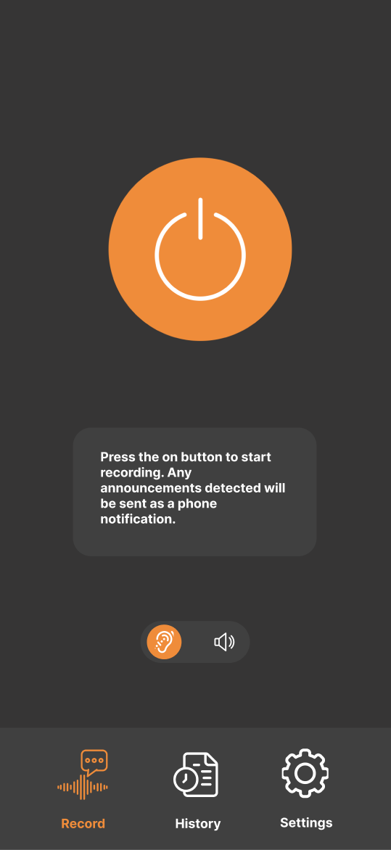
Main Menu

Slide 7

Tabs

Slide 8
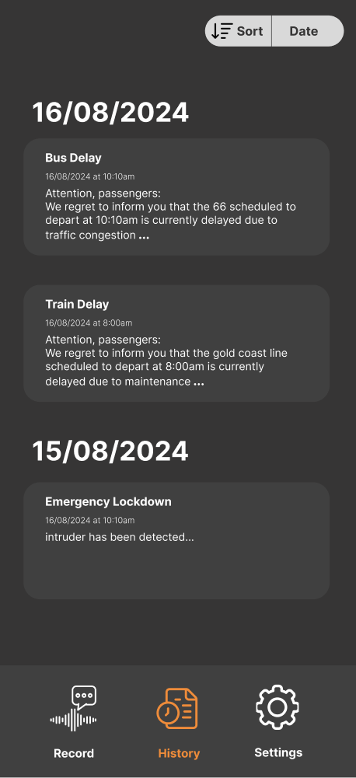
Announcement Log

Slide 9
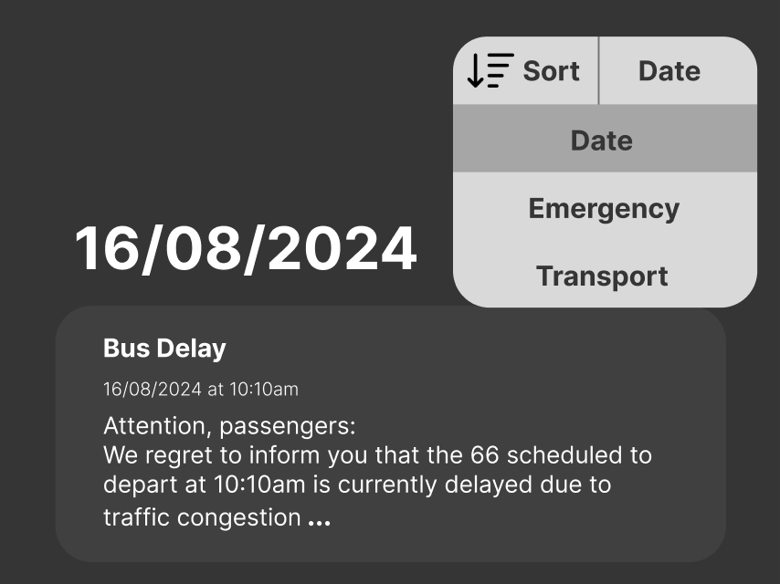
Sorting Feature

Slide 10
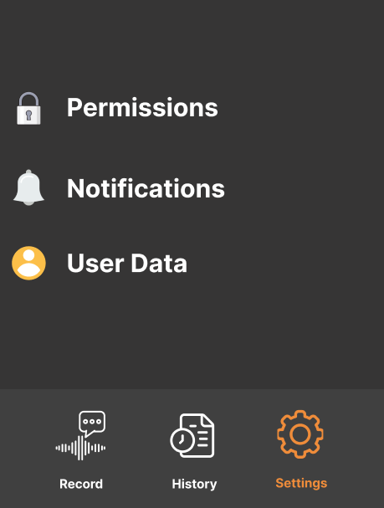
General Settings

Slide 11

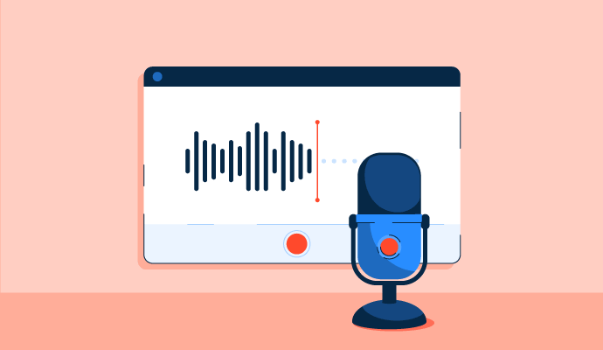
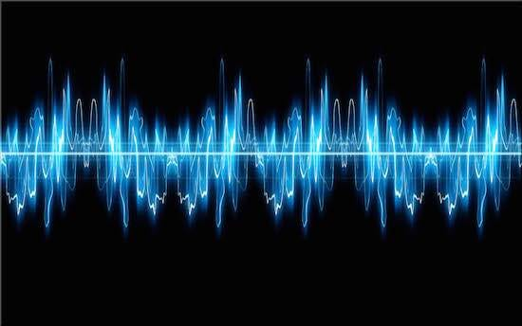
Backend progress
Audio recording
Audio processing
Notification system

Slide 12

Workplan changes
Feasibility of hearing loop integration
Delays in timeline
Operating system to be implemented on

Slide 13
Ethics, data and security
Safety on the road
App can be distracting
Reading an alert while driving is dangerous
Usage of phone resources

Slide 14
Moving forwards
Organisation zone notification/announcement sending
Real time live audio processing
Notification log
Hearing loop integration

Slide 15
References and acknowledgements
Hearing loops: https://www.unimelb.edu.au/accessibility/hearing-loops-demystified
Interview with Grace Luo

